Slide 1
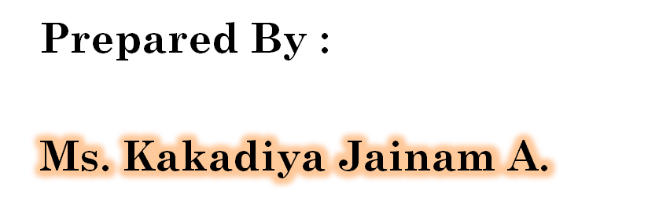
UNIT – 3
MVC Architecture,
EJB & Hibernate
Notes:
MONARCH Computer
By : Manoharsinh Gohil : Mo. 9429220505

Slide 2
INTRODUCTION TO MVC
Model View Controller or MVC as it is popularly called, is a software design pattern for developing web applications. A Model View Controller pattern is made up of the following three parts:
Model - The lowest level of the pattern which is responsible for maintaining data.
View - This is responsible for displaying all or a portion of the data to the user.
Controller - Software Code that controls the interactions between the Model and View.

Slide 3
MVC is popular as it isolates the application logic from the user interface layer and supports separation of concerns.
Here the Controller receives all requests for the application and then works with the Model to prepare any data needed by the View.
The View then uses the data prepared by the Controller to generate a final presentable response. The MVC abstraction can be graphically represented as follows.

Slide 4
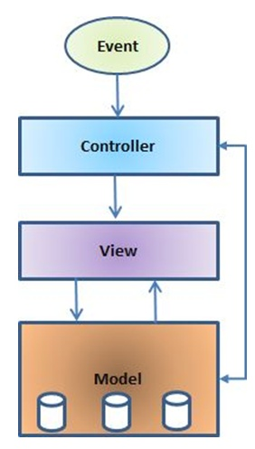
ARCHITECTURE OF MVC

Slide 5
(1) The model
The model is responsible for managing the data of the application. It responds to the request from the view and it also responds to instructions from the controller to update itself.
(2) The view
A presentation of data in a particular format, triggered by a controller's decision to present the data. They are script based templating systems like JSP, ASP, PHP and very easy to integrate with AJAX technology.

Slide 6
(3)The controller
The controller is responsible for responding to user input and perform interactions on the data model objects.
The controller receives the input, it validates the input and then performs the business operation that modifies the state of the data model.

Slide 7
EJB
Notes:
MONARCH Computer
By : Manoharsinh Gohil : Mo. 9429220505

Slide 8
WHAT IS ENTERPRISE JAVA BEAN
Java EE is great deal more than just Enterprise Java Beans [EJB’s] as many java developer think it is.
Java EE is a suit of specifications for -APIs, -Distributed Computing Architecture and -Definitions for packaging of distributable components for deployment.
It is a collection of -Standardize components, -Containers and -Services for creating and deploying distributed applications within a well defined computing architecture.

Slide 9

ENTERPRISE JAVABEANS ARCHITECTURE
The EJB architecture specifies the responsibilities and interactions among EJB entities
The EJB architecture specifies the responsibilities and interactions among EJB entities
EJB Servers
EJB Containers
Enterprise Beans
EJB Clients
Enterprise
Bean
Enterprise
Bean
EJB Container
Clients
EJB Server

Slide 10
Internet technology has changed the way that user interactions are supported, Java EE has responded by making available a platform that supports just this.
For example, the stateless nature of HyperText Transfer Protocol [HTTP] ensures that a client does not have a permanent connection with the server.
A basis for tying together the many technologies that required to develop and deploy enterprise wide commercial application.

Slide 11
BENEFITS OF ENTERPRISE JAVA BEAN
The major features of enterprise java bean are:
1) Platform Support: -The primary focus of Java EE is to ease development and hence, the java EE platform offers developers ready access to secure, portable and scalable platform for their enterprise application.

Slide 12
2) Java Server Faces 1.2 and Ajax Technologies -Java Server Faces technology simplifies the building of user interface for the web application through its well defined components, State and event framework.
3) The Java Developer’s Productivity -The use of annotation and the simplification of EJB and Web Services API have contributed to reducing amount of code a developers need to write.

Slide 13
TYPES OF BEAN
The different different types of Enterprise Java bean are availabl in Bean Directory.
There are main four types of Bean :
1) Session Bean
2) Entity Bean
3) Message Driven Bean

Slide 14
There are three different types of EJB that are suited to different purposes:
  Session EJB : A Session EJB is useful for mapping business process flow (or equivalent application concepts).
  There are two sub-types of Session EJB — stateless and stateful represent "pure" functionality that is created as it is needed.

Slide 15
  Entity EJB: An Entity EJB maps a combination of data (or equivalent application concept) and associated functionality.
  Entity EJBs are usually based on an underlying data store and will be created based on that data within it.
  Message-driven : EJB—A Message-driven EJB is very similar in concept to a Session EJB, but is only activated when an asynchronous message arrives.

Slide 16
Hibernate
Notes:
MONARCH Computer
By : Manoharsinh Gohil : Mo. 9429220505

Slide 17
HIBERNATE OVERVIEW
Hibernate is an Object-Relational Mapping(ORM) solution for JAVA and it raised as an open source persistent framework created by Gavin King in 2001.
It is a powerful, high performance Object-Relational Persistence and Query service for any Java Application.
Hibernates its between Java objects and database server to handle all the work in persisting those objects based on the appropriate mechanisms and patterns.

Slide 18
HIBERNATE ADVANTAGES
Hibernate takes care of mapping Java classes to database tables using XML files and without writing any line of code.
Provides simple APIs for storing and retrieving Java objects directly to and from the database.
Hibernate does not require an application server to operate.
Manipulates Complex associations of objects of your database.

Slide 19
HIBERNATE ARCHITECTURE
The Hibernate architecture is layered to keep you isolated from having to know the underlying APIs.
Hibernate makes use of the database and configuration data to provide persistence services (and persistent objects) to the application.

Slide 20
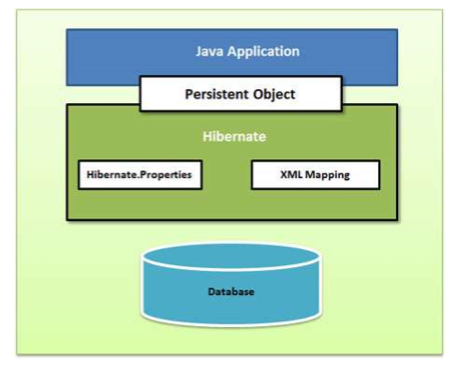
Following is a view of the Hibernate Application Architecture.

Slide 21
Previous diagram shows minimal architecture of Hibernate
It creates a layer between Database and the Application
It loads the configuration details like Database connection string, entity classes, mappings etc
Hibernate creates persistent objects which synchronize data between application and database

Slide 22
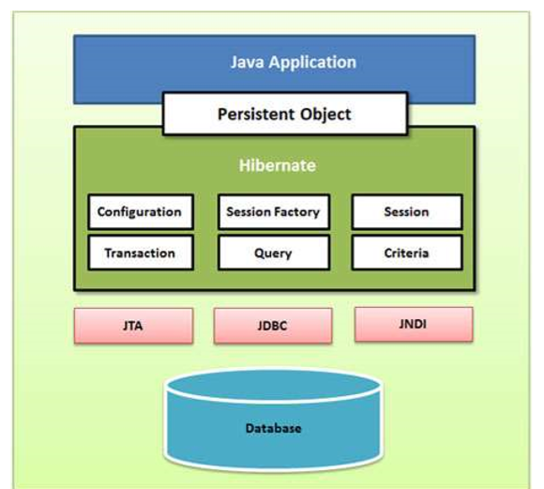
Let see this architecture in detail diagram
The above diagram shows a comprehensive architecture of Hibernate

Slide 23
HIBERNATE CONFIGURATION
Hibernate requires to know in advance where to find the mapping information that defines how your Java classes relate to the database tables.
Hibernate also requires a set of configuration settings related to database and other related parameters. All such information is usually supplied as a standard Java properties file called hibernate.properties, or as an XML file named hibernate.cfg.xml.

Slide 24
These files are needed for mapping and to load many other properties and create database connection
Hibernate provide following type of configurtions:
  hibernate.cfg.xml : – A standard XML file which contains hibernate configuration like database connection, class mappings etc and which resides in root of application’s CLASSPATH
  hibernate.properties : A Java compliant property file which holds key value pair for different hibernate configuration strings

Slide 25
Most of the properties take their default values and it is not required to specify them in the property file unless it is really required. This file is kept in the root directory of your application's classpath.
Hibernate Properties :
Following is the list of important properties you would require to configure for a databases in a standalone situation:

Slide 26
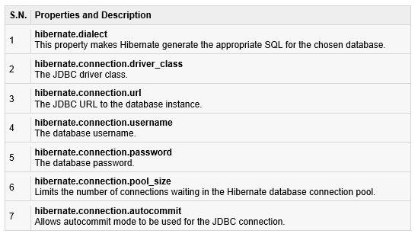

Slide 27
HIBERNATE MAPPING FILES
An Object/relational mappings are usually defined in an XML document.
This mapping file instructs Hibernate how to map the defined class or classes to the database tables.
Though many Hibernate users choose to write the XML by hand, a number of tools exist to generate the mapping document.

Slide 28
HIBERNATE MAPPING TYPES
When you prepare a Hibernate mapping document, we have seen that you map Java data types into RDBMS data types.
The types declared and used in the mapping files are not Java data types; they are not SQL database types either. These types are called Hibernate mapping types, which can translate from Java to SQL data types and vice versa.
lists down all the basic, date and time, large object, and various other built-in mapping types.

Slide 29
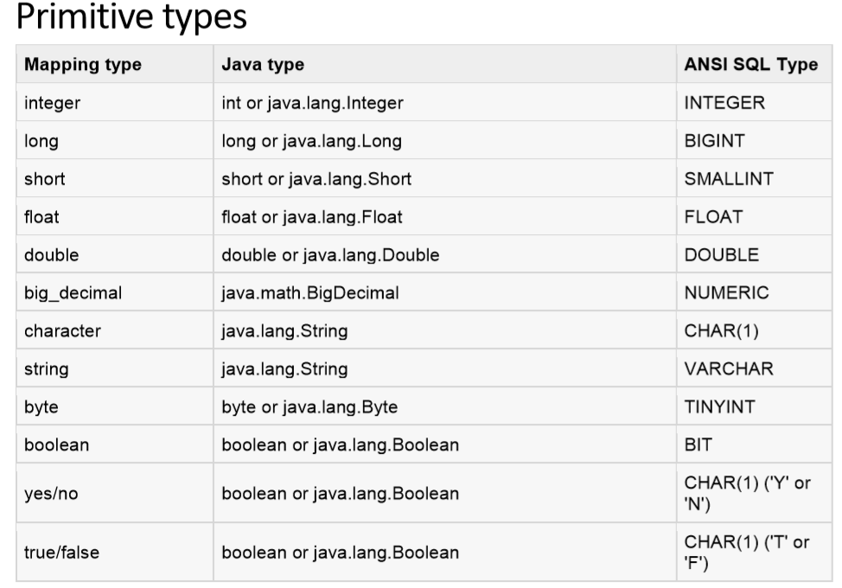

Slide 30
BASIC EXAMPLE OF HIBERNATE
public class Employee {
private int id;
private String firstName;
private String lastName;
private int salary;
public Employee() {}
public Employee(String fname, String lname, int salary) {
this.firstName = fname;
this.lastName = lname;
this.salary = salary; }

Slide 31
public int getId() {
return id;
}
public void setId( int id ) {
this.id = id;
}
public String getFirstName() {
return firstName;
}
public void setFirstName( String first_name ) {
this.firstName = first_name; }
public String getLastName() {
return lastName;
}

Slide 32
public void setLastName( String last_name ) {
this.lastName = last_name;
}
public int getSalary() {
return salary;
}
public void setSalary( int salary ) {
this.salary = salary;
}
}

Slide 33
HIBERNATE ANNOTATIONS
Hibernate annotations is the newest way to define mappings without a use of XML file. You can use annotations in addition to or as a replacement of XML mapping metadata.
Hibernate Annotations is the powerful way to provide the metadata for the Object and Relational Table mapping.
Same like JSF and other frameworks of java , Hibernate also supports annotations

Slide 34
HIBERNATE SESSIONS
A Session is used to get a physical connection with a database.
The Session object is lightweight and designed to be instantiated each time an interaction is needed with the database. Persistent objects are saved and retrieved through a Session object.
The session objects should not be kept open for a long time because they are not usually thread safe and they should be created and destroyed them as needed.

Slide 35
The main function of the Session is to offer create, read and delete operations for instances of mapped entity classes.
Instances may exist in one of the following three states at a given point in time:
• transient: A new instance of a a persistent class which is not associated with a Session and has no representation in the database and no identifier value is considered transient by Hibernate.

Slide 36
• persistent: You can make a transient instance persistent by associating it with a Session. A persistent instance has a representation in the database, an identifier value and is associated with a Session.
• detached: Once we close the Hibernate Session, the persistent instance will become a detached instance.

Slide 37
TIMER SERVICES
Timer Service is a mechanism by which scheduled application can be build.
For example, salary slip generation on the 1st of every month. EJB 3.0 specification has specified @Timeout annotation, which helps in programming the EJB service in a stateless or message driven bean.

Slide 38
Steps to Create Timer
Inject SessionContext in bean using @Resource annotation −
  @Stateless public class TimerSessionBean { @Resource private SessionContext context; ... }
  Use SessionContext object to get TimerService and to create timer. Pass time in milliseconds and message.
  public void createTimer(long duration) { context.getTimerService().createTimer(duration, "Hello World!"); }

Slide 39
DISADVANTAGES OF HIBERNATE
EJB solution does present some disadvantages. Even more surprising, despite what you may have read over the past six months about these disadvantages, they are almost all avoidable when you know how:
1) Large, complicated specification
2) Increased development time
3) Added complexity compared to straight Java classes
4) Potential to produce a more complex and costly solution than is necessary
5) Continual specification revisions

Slide 40
JARS FILES OF HIBERNATE
Framework software will be in the form of a set of jar files, where one jar file acts as main (We can call this file as core) and remaining will acts as dependent jar files.
Each Framework software contain at least one configuration xml file, but multiple configuration files also allowed.

